Slide 1
QI-Notefile Tutorial
Outline of Tutorial and Text

Slide 2

Requirements
Notecard CLI executable
cURL

Slide 3
Inbound Queues
Get command data sent to the Notecard from the cloud

Slide 4
Prerequisites
CLI Tutorial for Sending Data to the Cloud (Quickstart)

Slide 5
General Workflow Steps
Get Product UID and Device UID
Add QI-Notefile to Notehub (cloud)
Force Sync
Request Inbound Notes
Access Inbound Note content?

Slide 6
Get Product UID & Device UID using notecard CLI
Windows Mac Linux
C:\notecard> dir /b
notecard.exe
C:\notecard> notecard -play
You may now enter Notecard JSON requests interactively.
Show sync activity by using "w" to toggle Watch Mode on/off.
>
> {"req":"service.get"}
{"sn":"my_serial_number","mode":"periodic","host":"a.notefile.net","product":"com.blues.workshop.demo","device":"imei:865284040125662"}
>
Connect Notecarrier with Notecard via USB to your computer
Open system command prompt
Change current directory to location that has notecard executable
Enter notecard -play
Enter {"req":"service.get"}
Copy value of "product" field
e.g.: com.company.group.product
Copy the value of the "device" field
e.g.: imei:865284040125662
Press CTRL-C to exit interactive mode
4
5
6
7
More Info

Slide 7
Add QI-Notefile on Notehub using cURL
 | Description | Example
<product_uid> | Product UID identifies which Notehub project to append a notefile | com.mycompany.mygroup.myproject
<device_uid> | Device UID | imei:865284040125662
Open system command prompt
Enter cURL command as shown on the right
Replace <product_uid> and <device_uid> in the command with your specific product uid and device uid.
The QI file extension designates this as an inbound queue going from Notehub to a Notecard
Linux
curl -L 'http://api.notefile.net/req?product="<product_uid>"&device="<device_uid>"' -d '{"req":"note.add","file":"message.qi","body":{"text":"my first message"}}'
Windows*
curl -L "http://api.notefile.net/req?product=\"<product_uid>\"&device=\"<device_uid>\"" -d "{\"req\":\"note.add\",\"file\":\"message.qi\",\"body\":{\"text\":\"my first message\"}}"
* Escape double quotes contained within the command on Windows.
i.e: \"

Slide 8
Sync Notecard with Notehub using notecard CLI
Windows Mac Linux
C:\notecard> dir /b
notecard.exe
C:\notecard> notecard -play
You may now enter Notecard JSON requests interactively.
Show sync activity by using "w" to toggle Watch Mode on/off.
>
> w
sync activity watch now ENABLED
> {"req":"service.sync"}
{}
wireless: starting communications {wait-module} {connecting}
wireless: modem now ON
wireless: obtaining essential configuration information from modem
wireless: waiting for wireless service {wait-service} {connecting}
.
.
.
work: download message.qi (1 changes)
work: completed
work: begin (anything pending)
work: completed
notehub: closed notehub
wireless: modem now OFF (was active 60 sec, 15177 bytes transferred)
Enter notecard –play to start interactive mode
Enter "w" to start sync watch
Enter {"req":"service.sync"}
*When the sync is complete, you should see “download message.qi” in the sync messages.
If you don’t see this message, and you see the message
“modem now OFF (was active xx sec)…”
try a re-sync by entering the command from step 3 again.
1
2
3
*

Slide 9
Sync Notecard with Notehub using notecard CLI
Windows Mac Linux
>
> {"req": "note.get","file":"message.qi"}
{"body":{"text":"my first message"}}
1
Enter
{"req": "note.get","file":"message.qi"}
You should see a JSON object that contains "my first message"

Slide 10
Add QI-File to Notehub
Using Notehub API to send data from cloud to a device

Slide 11
Requirements
cURL
or
Postman

Slide 12
General Workflow Steps
Get Product UID
Get Device UID
Using Notehub
Using notecard CLI
Send QI-File request to Notehub
Using cURL
Using POSTMAN

Slide 13
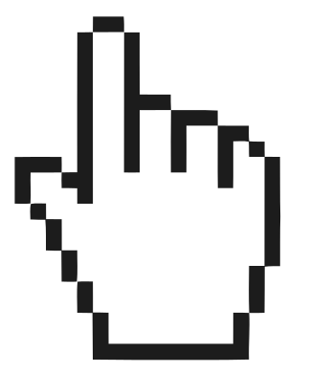
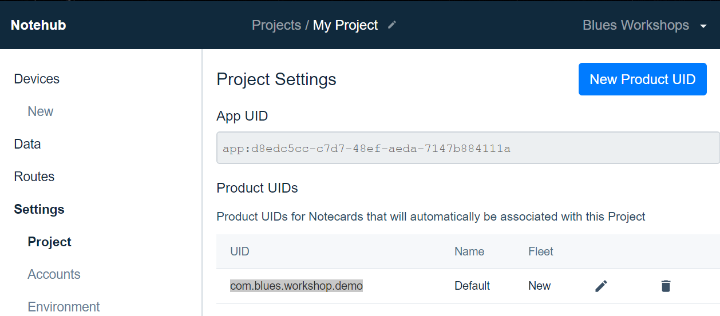
Get Product UID
Navigate to https://notehub.io/projects
Select a Project
e.g.: My Project
Click “Project” under “Settings” header on navigation tree
Highlight and copy a UID from the available Product UIDs table
3
4

Slide 14
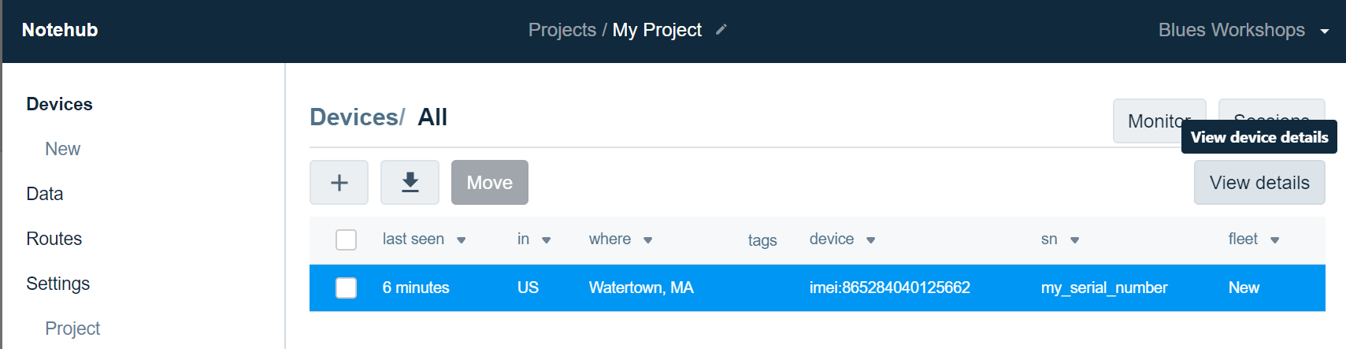
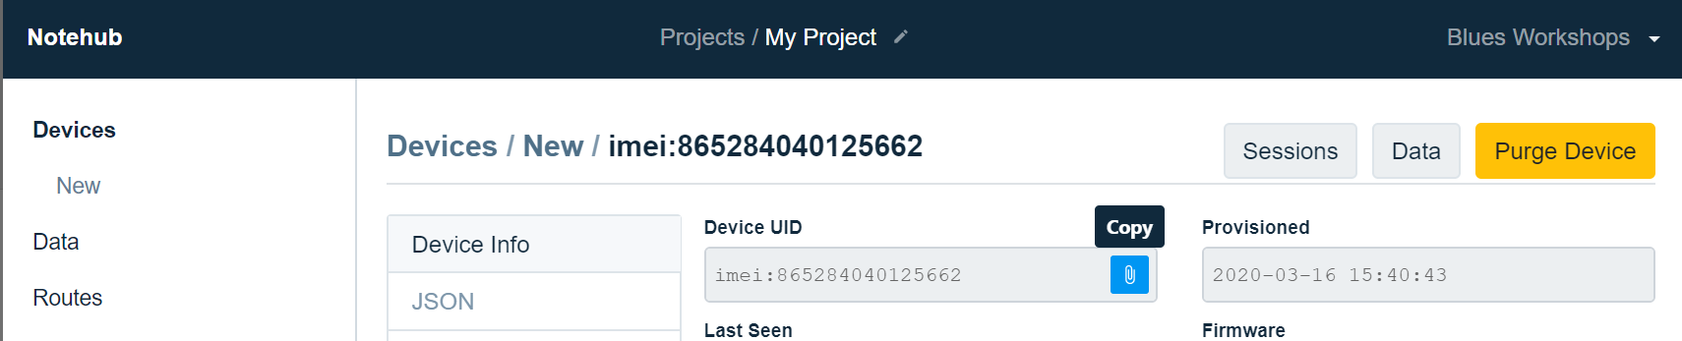

Get Device UID using Notehub
3
Navigate to https://notehub.io/projects
Select a Project
e.g.: My Project
Click “Device” in navigation tree
Select the row in the Devices table
Click View Details button
Hover mouse over right side of Device UID field
Click to copy Device UID to clipboard
5
4
6

Slide 15
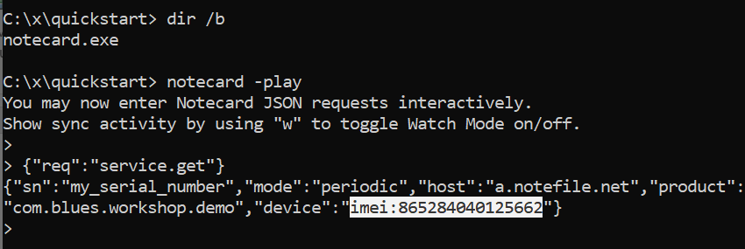
Get Device UID using notecard CLI
4
Connect Notecarrier with Notecard via USB to your computer
Open system command prompt
Change current directory to location that has notecard executable
Enter notecard -play
Enter {"req":"service.get"}
Copy the value of the "device" field
e.g.: imei:865284040125662
Press CTRL-C to exit interactive mode
5
6

Slide 16
Create QI-file on Notehub using cURL
 | Description | Example
<product_uid> | Product UID identifies which Notehub project to append a notefile | com.mycompany.mygroup.myproject
<device_uid> | Device UID | imei:865284040125662
<notefile.qi> | Name of Notefile syncing from Notehub to Notecard | my-inbound.qi
<body_json> | JSON data that is sent to Notecard | {"key1":"value1"}
Open system command prompt
Enter cURL command as shown on the right
* Replace <xxxx> in the command with your specific, product uid, device uid, notefile name, and JSON body.
Linux
curl -L 'http://api.notefile.net/req?product="<product_uid>"&device="<device_uid>"' -d '{"req":"note.add","file":"<notefile.qi>","body":<body_json>}'
Windows*
curl -L "http://api.notefile.net/req?product=\"<product_uid>\"&device=\"<device_uid>\"" -d "{\"req\":\"note.add\",\"file\":\"<notefile.qi>\",\"body\":<body_json>}"
* Escape double quotes contained within the command on Windows.
i.e: \"

Slide 17

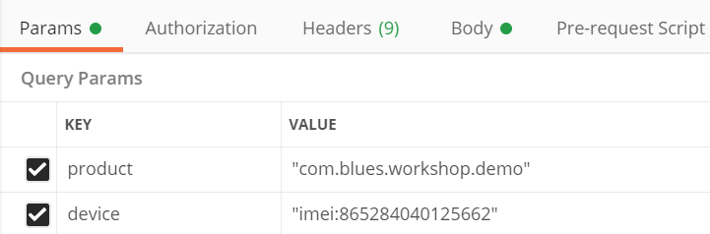
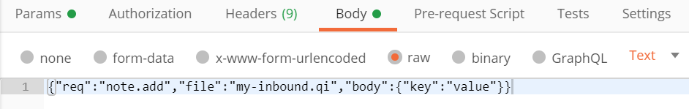
Create QI-file on Notehub using Postman
 | Description | Example
<product_uid> | Product UID identifies which Notehub project to append a notefile | com.mycompany.mygroup.myproject
<device_uid> | Device UID | imei:865284040125662
<notefile.qi> | Name of Notefile syncing from Notehub to Notecard | my-inbound.qi
<body_json> | JSON data that is sent to Notecard | {"key1":"value1"}
Open Postman and create a new query
Enter the following in the URL field
http://api.notefile.net/req
Select the Params tab and enter the following key/value pairs
4. Select the Body tab, and set the input type to “raw”
5. Enter the following JSON string
{"req":"note.add","file":"<notefile.qi>","body":<body_json>}
6. Click SEND button
Expected Response:
{}
2
product | "<product_uid>"
device | "<device_uid>"
3
4
5

